Slide 1
Mentors Make Mentors
7 Tips For Your Open Source Mentoring
Karsten Wade @quaid
Community Architect
Open Source Program Office at Red Hat
Copyright 2019 Red Hat & Karsten Wade released under CC BY SA 4.0
All images used under public domain or free/open content licenses, attribution on “Image credits” slide
Notes:
The challenge is a title, a call to action, a directive -- if you call yourself a mentor, your job includes making mentors out of people who come to you for mentoring and help.
The biggest risk of things going well, people too easily forget the struggles everyone and everything faces in getting started. Each individual and the whole ecosystem have roots and reasons for how open collaboration and community development is best done, some of which date back to when it was in the shadow.
While training courses and handbooks provide a lot of good resources for people diving into an open source community, it is ultimately the human relationship that builds trust and capacity for a project to move forward, together.
Key is mentoring. Those who know even the littlest bit about a project can help bring along others. Just as vital are those fewer of us who have been around for a while, we must help bring along the amazing and diverse community of individuals who now seek to collaborate with us.
This talk just hopes to help that work and further the discussion.

Slide 2
7 tips
In open source, mentoring is at least 15% of the job
Use the power of “to document”
Public & private - choosing & leveraging public
Create Communities of Practice to achieve scale
Outside-to-Inside & the power-responsibility of paying back
Mentor different levels - small instances & interactions have yield too
Meet people where they are & for what they need - small instances & interactions have yield too

Slide 3
Tip 1
In open source mentoring is simply part of the job
Start with the basic, honest truth -- you must commit time to mentoring, as individuals and as a group
15% to 50% but at least 15%
At the very least enable the enablers

Slide 4
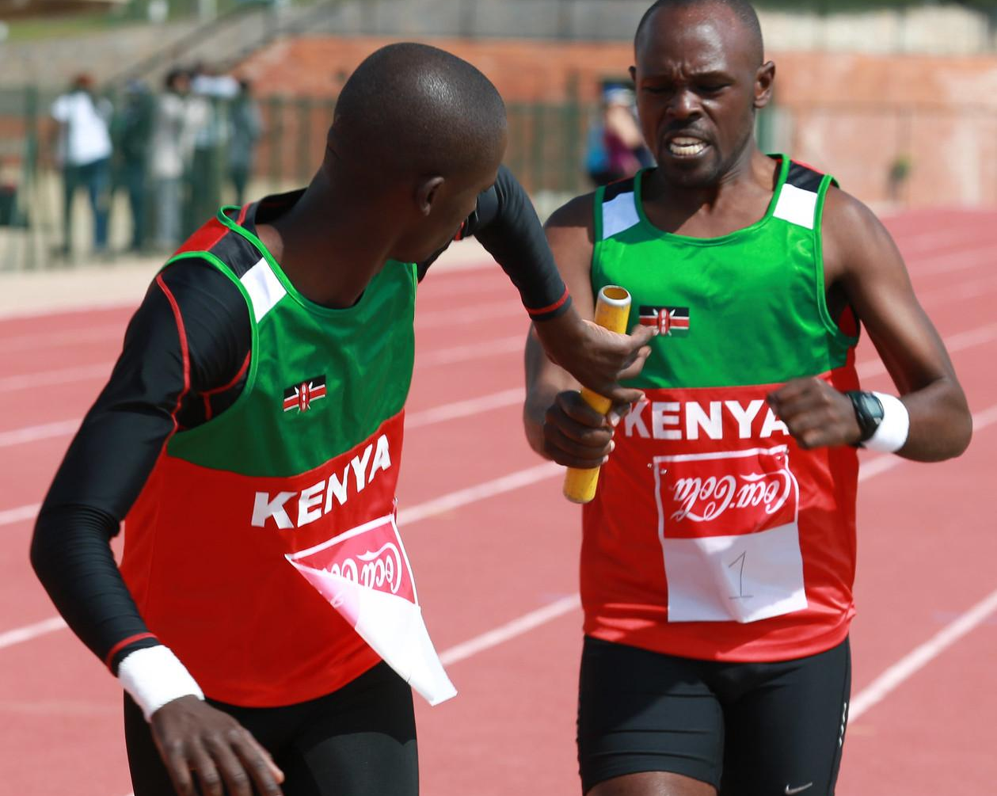
Tip 2
Use the power of “to document”
In showing people the pathway, where the documentation is lacking, empower them to help themselves & others
Hat tip to Prof Mel Chua
Taking the time to fix the broken Thing helps them become a Thing Fixer

Slide 5
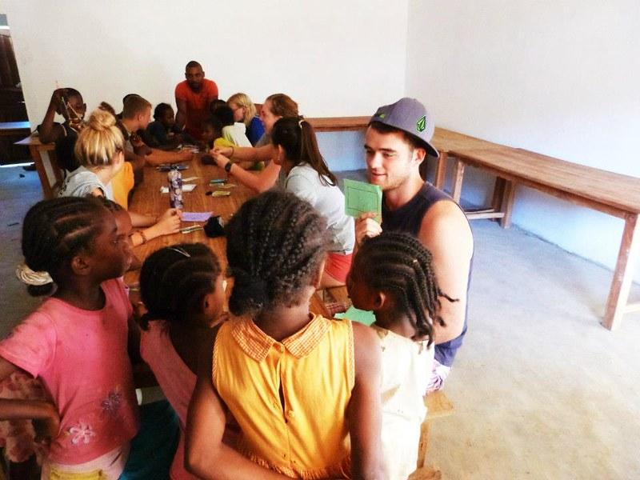
Tip 3
Public and private spaces - use them well
People are drawn to ask for your private energy; be wise & sparing
Public energy often pays back -- leverage the openness

Slide 6
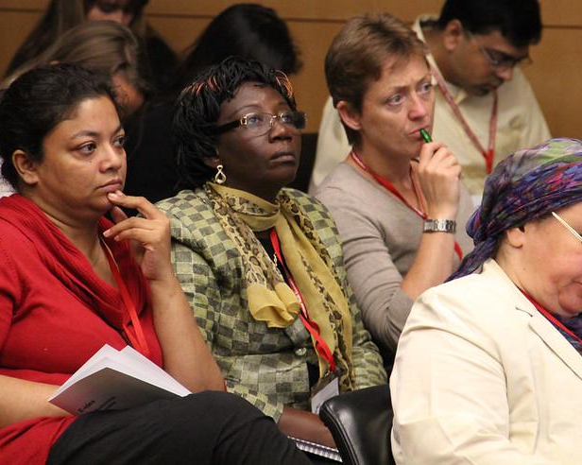
Tip 4
Create a Community of Practice to achieve scale
What is a CoP & what does it do for you?
Taking mentoring from repeatable to sustainable
Formalize or stay small-enough-to-reach
Small is OK ... but choose small

Slide 7
Tip 5
Outside-to-Inside & the responsibility|power of paying back
Joining becomes belonging, in/visible circles are entered
Just as your voice was wanted and needed for this community, all the other diverse voices are wanted and needed too

Slide 8
Tip 6
Mentor different levels
Small instances & interactions have yield too

Slide 9
Tip 7
Meet people where they are & for what they need -- small instances & interactions have yield too
OPTIONAL SECTION MARKER OR TITLE

Slide 10
Thank you!
Any questions?
I’ve been Karsten Wade
You can find me @quaid & kwade@redhat.com
twitter.com/redhatopen
Slides:
quaid.fedorapeople.org/presentations/OSSEU-2019/
OPTIONAL SECTION MARKER OR TITLE

Slide 11
Image credits
Tip 1: https://www.flickr.com/photos/cogdog/38504981284/ under public domain
Tip 2: https://www.flickr.com/photos/itupictures/17337858492/ under CC BY 2.0
Tip 3: https://www.flickr.com/photos/frontierofficial/8050042865/in/photostream/ under CC BY 2.0
Tip 4: https://www.flickr.com/photos/microlinks/8047790186/ under CC BY 2.0
Tip 5: https://www.flickr.com/photos/mdpettitt/16634881359/ under CC BY 2.0
Tip 6: https://www.flickr.com/photos/morville/4274389970/ under CC BY 2.0
Tip 7: https://www.flickr.com/photos/tom-margie/3087835894/ under CC BY 2.0
Thank you: https://www.flickr.com/photos/29224712@N08/2755905578/ under CC BY 2.0
Image credits page: https://www.flickr.com/photos/iquaid/543109357/ under CC BY SA 2.0
OPTIONAL SECTION MARKER OR TITLE

Slide 12
Thank you
Red Hat is the world’s leading provider of enterprise open source software solutions. Award-winning support, training, and consulting services make Red Hat a trusted adviser to the Fortune 500.
Copyright 2019 Red Hat & Karsten Wade released under CC BY SA 4.0
All images used under public domain or free/open content licenses, attribution on “Image credits” slide

