Slide 1

Participate or Die
Location of Presentation
Karsten Wade
Community Gardener, Red Hat
This presentation is licensed under a Creative Commons
Attribution-ShareAlike (BY-SA) 3.0 license.
Notes:
Goals - introduce me, learn about the audience make-up, learn what they know about open source and community projects such as Fedora.
Does open source affect your business? Academic interests? Are you an educator or a student?
Is open source applicable to your life or not? Your personal life?
This talk is an evolving talk I am giving at LFNW for the first time.

Slide 2
Open source and free culture
The four freedoms:
0. The freedom to run/use for any purpose
1. The freedom to study and modify
2. The freedom to copy and use to help others
3. The freedom to improve and distribute to your community
Cf. scientific method
Free culture is about sharing and social media – the remix
Free culture is defining the business and social environment
Notes:
Understand and be prepared to speak on the four freedoms and how that fuels remix and free culture. Examples of why it is relevant:
Underpinning for all free and open source software
Creative Commons and millions of musician sharing ideas freely
Sharing culture so that a small contribution of e.g. a how-to video adds to a pool of how-to videos you and your friends draw on
Rapidly developed and responsive social tools creating participant communities that mirror the open source communities that build the software underneath the social tools. Do viral memes move from the code to what is written with it?

Slide 3
Communities of participation
What is a participation community?
How is it different from a user-focused
or consumer community?
Are there evident truths about building
communities of participation?
Notes:
Goals - Take a few minutes to talk about participation before explaining why it's so important to you and your future that you do some of it.
What is a participation community? How is it different from a user-focused or consumer community?
Participation communities invite people to get more by doing more, usually with a force-multiplying effect. They put in N, they get back Nx5. Participation communities have something you can do and make it possible to do it, whatever it is.
There are a certain group of people, who are quite large in number, just along for the ride. They fill up a lot of space on the bus, but they don't contribute much more than sometimes paying a fare. And none of that for most FLOSS.
[Add on about evident truths]
When looking at how and why we build communities of participation, there are clearly some evident truths, and a handful of best practices and reasons.

Slide 4
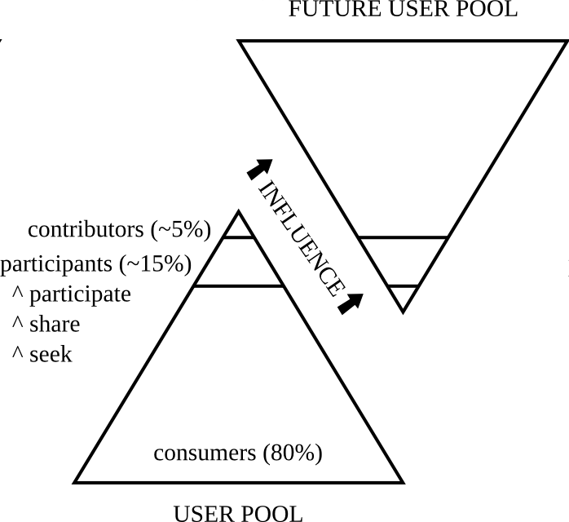
Communities of participation
Notes:
This is the pyramid of contribution. Imagine it as representing one pool of users, such as iPod owners, ProTools users, or users of a Linux operating system. Out of every one hundred of them, there is a break down of participation levels that is a set of numbers we reverse engineered by observation in the wild. These correspond to other similar figures, such as market research showing that for every 100 users on specialty forums on the web, 90 are passive readers, 9 are commentators of varying degrees, and 1 will be a strong contributor in one or more areas of the forum.
Similarly, in FLOSS we see that about 80% are drawn to simply use a piece of software, with minimal interaction beyond that. Some of those people are going to be drawn to participate, usually first by seeking knowledge, then my sharing that knowledge and new knowledge they learn, and moving up to self-recognition and group recognition as a participant. Somewhere in there, a % of the participants will rise all by themselves to be full contributors.
Most marketing practices have traditionally focused on the 80%. After all, if they have 80% of the money ... We focus on the contributors and the participants, and here is why ... (next slide)
"You cannot normally take someone from zero to contributor; they have to pass through some % of the stages of participation, then self-select to contribute. Participants can be drawn in and even created, but contributors are self-made."

Slide 5
Communities of participation
Notes:
The contributors are the group that have the greatest potential of positively influencing the largest number of future people, including drawing in other participants and contributors.
The consumer portion of the pool has the lowest impact on influencing new people. For every five or ten persons from this group, they might influence the buying decision of one person.
The participant group is self-identified. This role occurs everywhere, for example, the instinc, research, and deal-seeking of a fashion-wearing friend who influences the purchasing decisions of all his friends.
The contributor group that has the greatest potential to influence, thus drawing in even more people (future groups.) To illustrate, there was a point in 2008 when the Fedora Project decided to change from the Moin Moin wiki to Media Wiki. While scalability on the IT/infrastructure side was key, we hoped to benefit from the wider base of MW users (people who know the syntax and conventions), and some of the Wikipedia page authoring and maintenance magic.
In all this, an email came to the Infrastructure group from Ian, who had been participating a bit in some parts of the Project, but hadn't found somewhere to make a real contribution that mattered to him. He offered to help, give him a shout, and the Infra lead, Mike, did that right away. Within a few weeks, Ian was everywhere – debugging migration scripts, coding and integrating PHP modules, and most importantly, teaching us the MediaWiki Way. Whenever we stray, this young man who is now the Wiki Czar, would set us on the right path. He makes sure we get all the value we can out of the amazing base of community documentation best practices that the Wikimedia Foundation have amassed. When Ian started all this, he was a 16 year old high school student looking for something to do where his schoolwork wasn't satisfying.

Slide 6
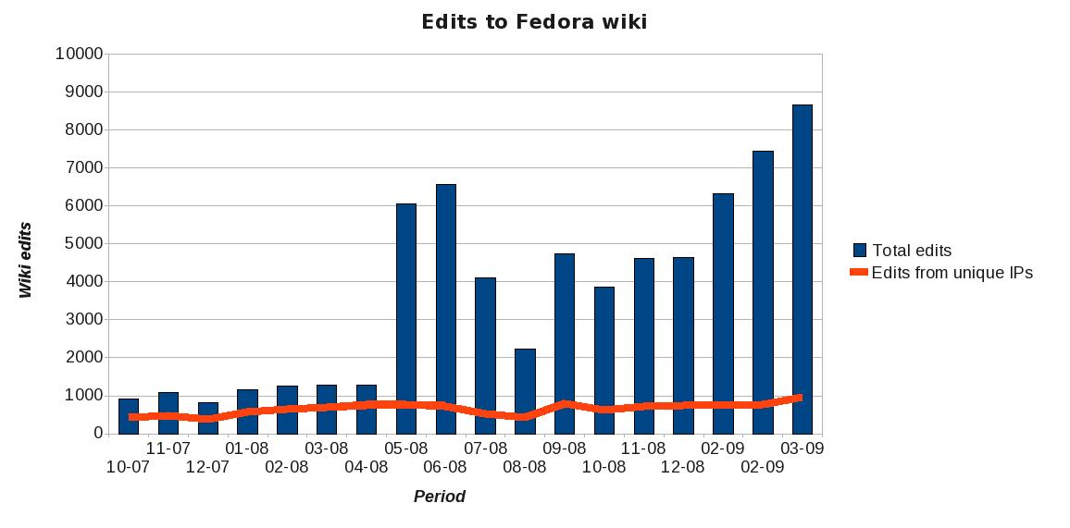
Communities of participation
Notes:
This graphic demonstrates that power of one contributor from Ian's story.
The point where the bars jump is when we migrated to MediaWiki. The initial spike is probably the pages being imported, but right away we saw a large increase in usage. It went along, then dropped a bit, and that was when Ian and some others formed a special interest group (SIG) around the wiki. By improving the help documentation, enforcing standards, and helping more and more people, we were able to increase the page edits once again. The next spike of page edits begins with the FUDCon in January 2009. There was a project begun there to rename a large number of pages to make them easier to find, read, and contribute to. In this case, a few new contributors, especially Susan, began reworking the wiki, which has continued to draw more attention, and so on.
It is a certainty that without Ian's initial efforts, the migration and subsequent successes would not have occurred. And while this is a testament to Ian, if he had not stepped up, someone else might, and the same thing would have occurred. By enabling and listening for contributors, the Fedora Project was able to get out of Ian's way to make a difference in the daily lives of 13.5 million Fedora users and additional interested people.

Slide 7
Examples of participation communities
Wikipedia
Specialty software forums
Other forums (gadget, shopper)
YouTube etc.
Grateful Dead and old timey music
Notes:
Aside from being varied in personality, different participation communities have different qualities to the contributions, different flavors.
Wikipedia – This is a premier example of a low-barrier to entry participation community. Literally anyone can edit or add comments to the discussion page. I often suggest this to K-12 educators as a great way to get classrooms involved as contributors and not just consumers of Wikipedia.
Flavor – Sharing, social status
Specialty software forums – these are communities focused around a software product, usually in the hand of professionals or “prosumers”. For example, ProTools for audio or Final Cut for video. These groups support each other in absence or supplement to the paid support, and do their forum work usually on sites sponsored by the software vendor. Note – some of us still haven't gotten this formula right, such as Red Hat. :)
Flavor – Helping others helps yourself, and gaining karma/social status
Other forums – such as shopper ranking sites and gadget forums. These are not great bastions of contributors, but they are easy to participate in, and they do a valuable service that rides on crowdsourcing.
Flavor – Helping and rating
YouTube etc – these are core to the burgeoning culture of sharing on the Internet. While stories in the popular press about these sites focus on the anomolies, such as shared items that gain extreme popularity and fame, the real value of the service is happening in the long tail, where the community ranking helps find the gems amidst the ashes.
Flavor – Participate through sharing and rating
* Grateful Dead & any old timey music – this is the commons that Creative Commons was named from. People play for each other, learn, adopt, and share the the result, constantly remixing old to new.
Flavor – Improvement and entertainment through sharing, social prestige

Slide 8
How participants are attracted
Low barriers to entry
Friendly and welcoming
Something they see they can do right away
Recognition and social status
... which leads to ...
Notes:
These are the basics. There are many more subtleties, but these are the commonalities that need to be considered and covered for any participation community.

Slide 9
Why do people participate ...
and why should you?
General reasons and specific reasons
Specific audiences such as business and education
General reasons and specific reasons
Specific audiences such as business and education
Notes:
There are some general reasons people should and do participate, as well as specific reasons depending on which groups they identify with.

Slide 10
Why should businesses participate?
Uses open source tools ...
Relies upon FLOSS as a core competency ...
Is an upstream ...
... but many ignore this
Notes:
If the business uses open source tools for commodity tasks, participation is a low-cost way to get training, support, and collaboration from the community. You give X and receive 5X or 10X in return.
If the business relies upon free software as part of their core competency, that is, they make money because_ of the open source nature of their software -- for example, financial institutions who ain from faster message queueing working in AMQP.
If the business has one or more upstreams, it will naturally gravitate to supporting general open source projects as participating users and contributors in various fashions.
Many businesses ignore this opportunity. Systems integrators, for example, who have a vested interest in seeing specific hardware and software combinations work. Participating by tracking rawhide in Fedora, filing bugs, and helping to drive QA/Testing days.

Slide 11
Why should educators participate?
Immerse a class in methodology ...
Shared maintenance of courseware ...
Teaches academic quality that also prepares
for the rest of career ...
... but dead-code autopsies are the norm
K-12 – need Linux to get to 1:1 ...
... prepares for a world of DIY, collaboration,
and self-responsibility
Notes:
Immersing a class in the open source methodology provides the best of academic, scientific, and real-world methods in one package.
Maintenance of courseware (reuse year-over-year) can be reduced using an open content model.
K-12:
If we ever intend to get to 1:1 computing, it is going to require Linux. The case for *using* open source is clear. For example, the low cost and ubiquity (Firefox, OpenOffice, Thunderbird) mean students can have the same software if they have home computers.
Preparation for a world of collaboration, DIY, and self-responsibility.

Slide 12
Why should students participate?
Yay! Friends ...
Where your future happens right now ...
Take control of what you care about ...
Notes:
One of the most important draws to participation communities are friends. People go to where their friends are. A social network, for example, is only successful when people who are central nodes in networks of friends. People put their energy in where they find the most current or potential value.
We're all looking at what we want from our future, to varying degrees. Open source and open collaborations are a way to get involved in work that will beneficially follow you for life.
Part of growing older is getting the opportunity to take increasing control of your own life. Open collaboration projects are a wonderful method of taking control of what matters to you the most.

Slide 13
Why should anyone participate?
It's what the cool kids are doing ...
Ultimate invitation to participate ...
Embrace DIY for yourself ...
When friends get together to work on something
with meaning ...
Notes:
We are social creatures and really need to consider that there is value in doing what other people are doing, when we admire those people. This is not a good enough reason alone, but it is valuable. Don't participate in a community where you don't admire the people involved.
In general, humans like to help each other and be involved. Participation communities are centered around this concept, and are very inviting toward new people.
Participation communities give us a chance to embrace our desire to do things ourselves.
When friends get together to work on something with meaning, it strengthens the friendship and strengthens their work. Better friends, better outcome.

Slide 14
Enabling participation
Build an infrastructure that scales ...
Make radical transparency the rule ...
Practice radical transparency ...
Notes:
Build an infrastructure that scales and supports participation. Think about this from the start; the keys are to embrace open standards as implemented in open source, so you can switch technologies if you need in the future. Keep flexible, and use open tools that people are already familiar with – build on the training they've done with Wordpress, MediaWiki, Twitter, etc.
Make radical transparency the rule, not the exception. There are a lot of stories to back this up. Never have secrecy or ignoring transparency lead to a thriving open project.
Put all your needs out in public space and encourage people to grab and run with them. It is a surprisingly common situation where project members keep all the bumps and bruises (needs to be fixed) in their heads, and no one can just show up and get started on helping. Instead of being mindful about turning everything in to a massive task list, start by being so transparent that other people can write tools or discover your needs other ways. For example, when you are explicit in your commit messages about why content or code is in a certain state, observers are able to follow along and see where they can step in and add value.

Slide 15
Questions?
quaid@fedoraproject.org
join.fedoraproject.org
Notes:
Was this convincing?
Do you feel inspired to participate and also to encourage others to participate?
Do the ideas make sense?

